Slide 1
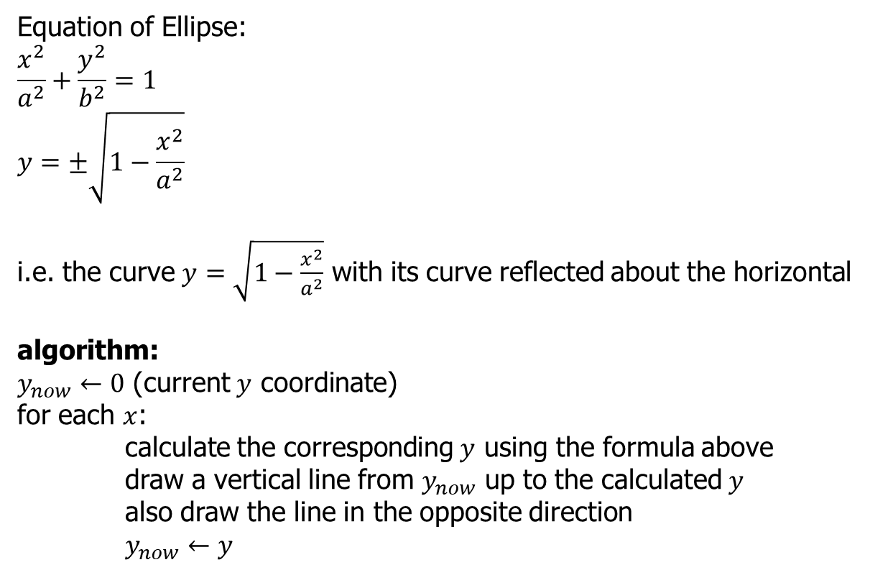
Equation of Ellipse:
$$\frac{x^{2}}{a^{2}}+\frac{y^{2}}{b^{2}}=1$$
$$y=±\sqrt{1−\frac{x^{2}}{a^{2}}}$$
i.e. the curve $y=\sqrt{1−\frac{x^{2}}{a^{2}}}$ with its curve reflected about the horizontal
algorithm:
$y_{now}←0$ (current $y$ coordinate)
for each $x$:
calculate the corresponding $y$ using the formula above
draw a vertical line from $y_{now}$ up to the calculated $y$
also draw the line in the opposite direction
$y_{now}←y$

